Slide 1

Engineering Enzymes for Green Chemical Synthesis
Evan Reynolds
Associate Professor
Department of Chemistry & Physics
Campbell University

Slide 2

Fine chemical and pharmaceutical production is inefficient
Heavy Metals
Organic Solvents
Heat, Pressure
Environmental impact of chemical industries
Industry | E-factor (kg waste / kg product)
Oil refining | < 0.1
Bulk chemicals | < 1-5
Fine chemicals | 5 - > 50
Pharmaceuticals | 25 - > 100
Pharmaceuticals
R. A. Sheldon. Chem. Soc. Rev., 2012,41, 1437-1451

Slide 3


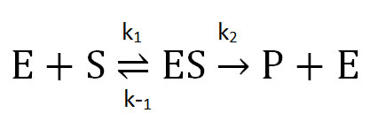
Qualities of an ideal “green” catalyst
Sustainable, non-toxic, and biodegradable
Cost-effective
Exhibit high turnover
Lead catalyst
Modify
Assess activity
Selective
Amenable to systematic improvements
Flexible substrate scope
Enzymes have the potential to meet these requirements!

Slide 4
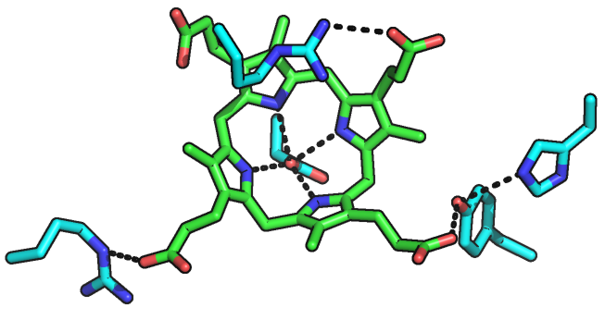
The power of enzyme catalysis
Enzymes are biological catalysts
Display exquisite rate enhancements
Perform under mild reaction conditions
Highly selective
Evolvable
Challenge:
How do we introduce new reactions to enzymes?
Example: uroporphyrinogen decarboxylase
Rate enhancement ~ 10¹⁷
No metals involved, only amino acid side chains
PNAS (2008) 105, 17328.

Slide 5
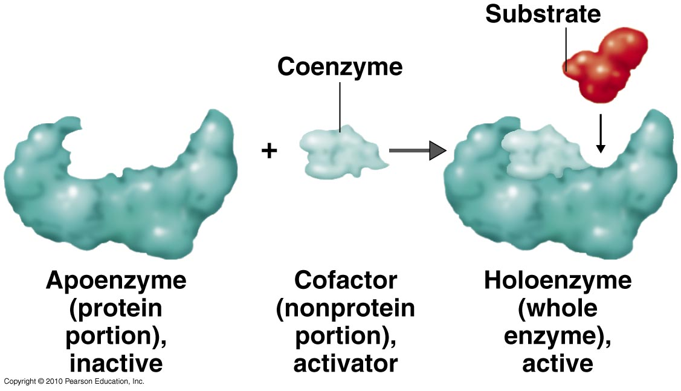
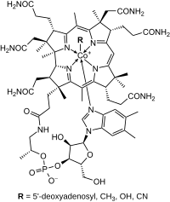
Cofactors expand enzymatic chemistry
Cofactors (or coenzymes) provide reactivity beyond that of the amino acids
Niacin, Vitamin B₃
Pyridoxine, Vitamin B₆
Thiamine, Vitamin B₁
Cobalamin, Vitamin B₁₂

Slide 6
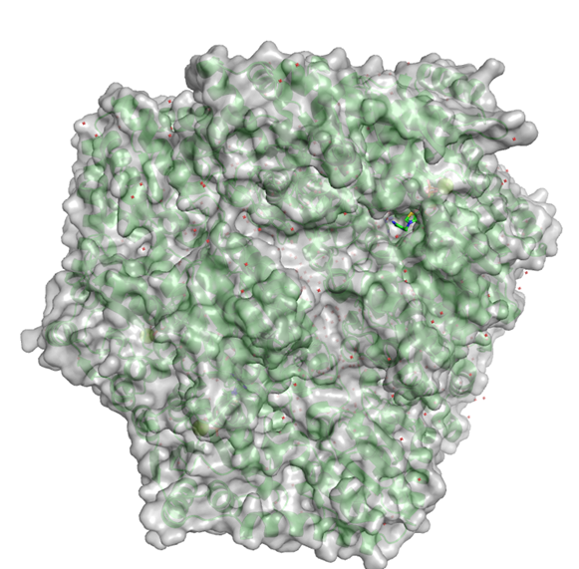
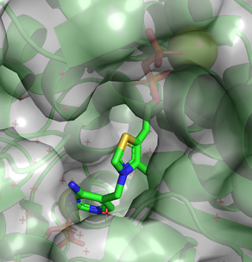
Thiamine-dependent enzymes are versatile catalysts
≡
Thiamine Diphosphate (ThDP)
In nature, thiamine-dependent enzymes catalyze a variety of carbon-carbon bond forming or breaking reactions
Prier, C. K.; Arnold, F. H. J. Am. Chem. Soc. 2015, 137, 13992–14006.

Slide 7
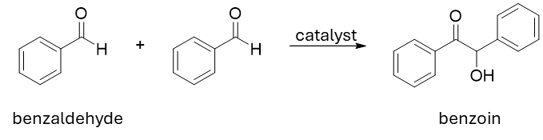
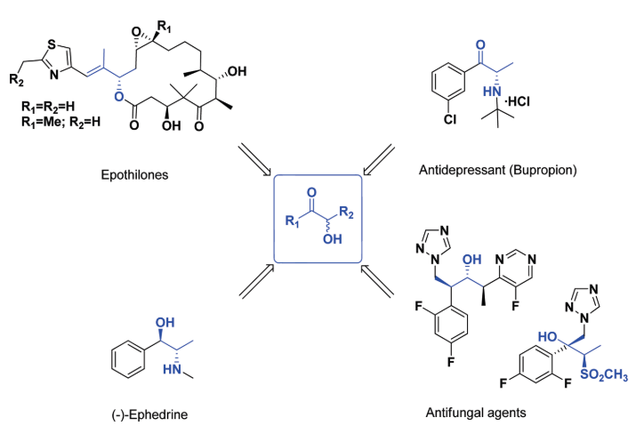
Chemistry inspired biocatalysis
Synthetic chemists have developed N-heterocyclic carbene catalysts that are similar to thiamine but catalyze many more reactions
Thiamine Diphosphate
Can we take advantage of the similarities between chemical catalysts and thiamine to introduce new reactions to enzymes?
Representative Synthetic Catalysts
Flanigan, D. M.; Romanov-Michailidis, F.; White, N. A.; Rovis, T. Chem. Rev. 2015, 115 (17), 9307–9387.
Hoyos, P., Sinisterra, J.-V., Molinari, F., Alcantara, A. R., & Dominguez de Maria, P. Accts. Chem. Res. 2010, 43(2), 288–299.

Slide 8
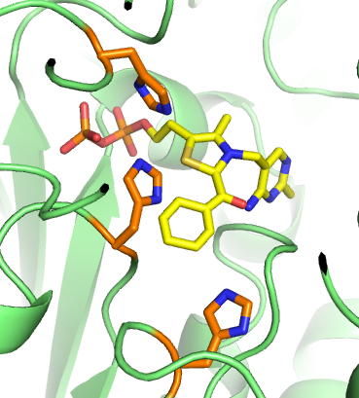
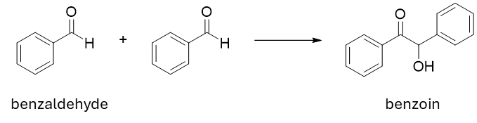
Engineering the thiamine-dependent enzyme SucA for benzoin condensation
Target: E1 subunit of the α-ketoglutarate dehydrogenase complex (SucA)
Thiamine-dependent enzyme from central metabolism
In nature, catalyzes decarboxylation of α-ketoglutarate
H460
H260
H298
α-ketoglutarate
α-ketoglutarate
dehydrogenase
complex

Slide 9
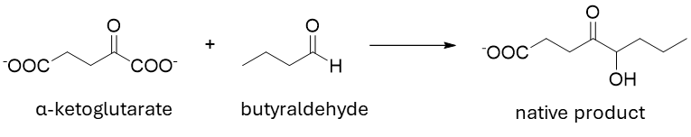
SucA variants for benzoin synthesis
Compared activity of unmutated wild type (WT) SucA to several mutants in the “native” reaction and in benzoin synthesis

Slide 10
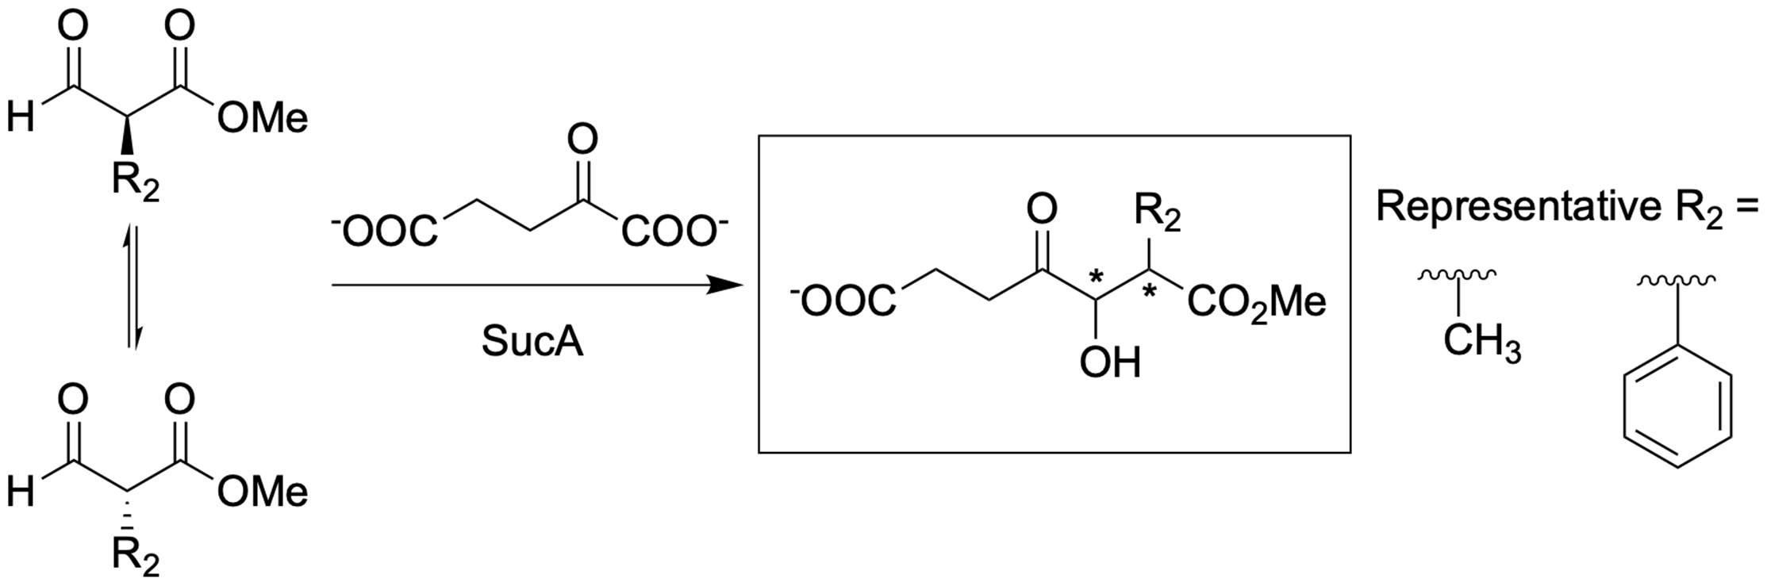
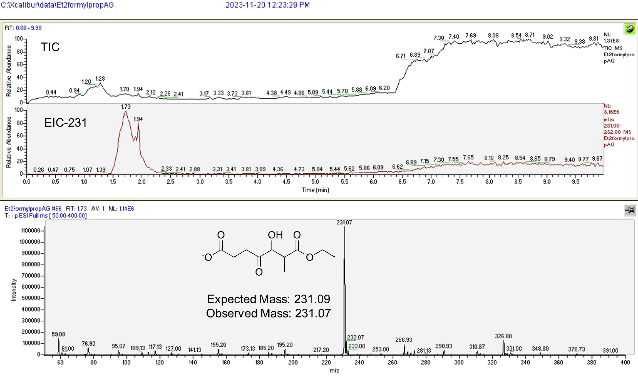
Pushing the limits of biocatalysis with SucA
Can we engineer the enzyme to make even more complex products selectively?

Slide 11
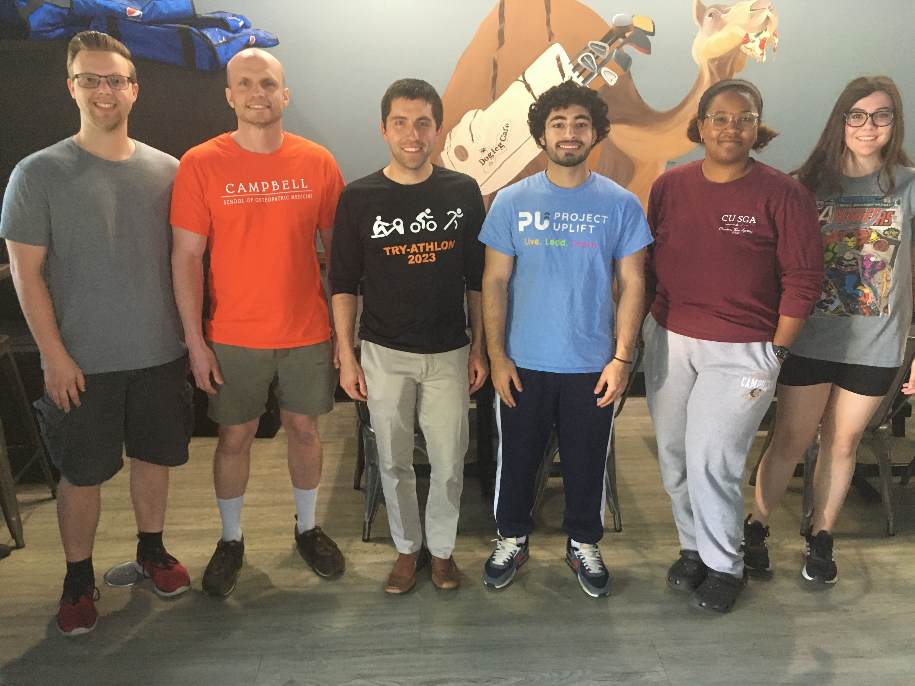



Acknowledgements
Special thanks to the Reynolds lab students, past and present:
Katherine Darrigrand
Haley Debnam
Stephanie Bryant
Jeremy Walker
Matthew Pare
Ryan Peterson
Angelique Girard
Jose Perez-Hernandez Kyra Gustus-Daniels Alex Stroud
Peter Robbins
Mable Hinshaw
Shane Galvin
Wyatt Welton
Charlie Creed
Sumiya Bibi
Inayat Zulfiqar
Monica Gonzalez-Garro
Nicholas Woodlief
Rachel Van Winkle
Thanks to the Campbell Chemistry & Physics Department, Howard Research Fellows Program, NCAS Yarbrough Award, NCICU Undergraduate Research Award, ACS Project SEED, and NSF LEAPS-MPS Award #2417808

